Slide 1
Current projects
TeSLA blot*
Single Copy Gene* - Finding a new SCG
ITS after Exonuclease treatment*
2d-ddPCR for Titer and impurity detection
Cut-only initial gDNA concentration tests
Genotyping of C9orf72 hexanucleotide repeats
Buccal cells kit testing for C9orf72 hexanucleotide repeats Genotyping
Designing a standard for telomere length measurement - ddPCR

Slide 2

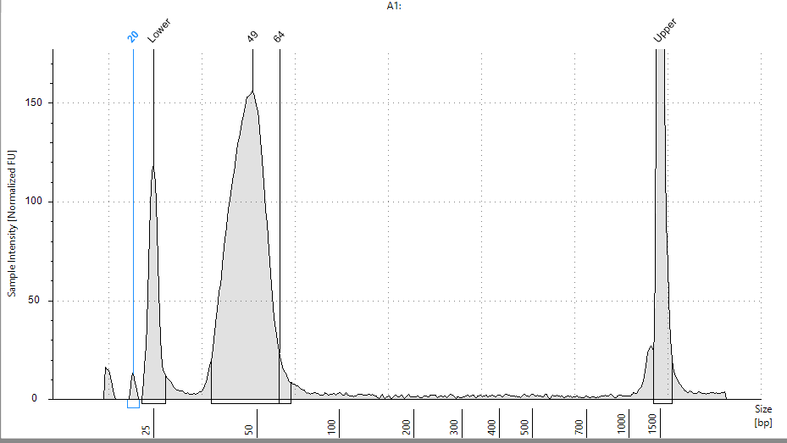
Genotyping of C9orf72 hexanucleotide repeats

Slide 3
Single copy gene
3 of 4 restriction enzymes used for both full TeSLA ddPCR and Cut-only digest the SCG at different locations.
They digest the original 646 SCG, leaving approximately 420 bp of the sequence. The cut fragment contains the target sequence for one of the primers designed for the Failsafe reaction.
Thus, it can explain the bad results obtained from full TeSLA ddPCR
SCG before Failsafe
SCG after Failsafe (shorter)

Slide 4
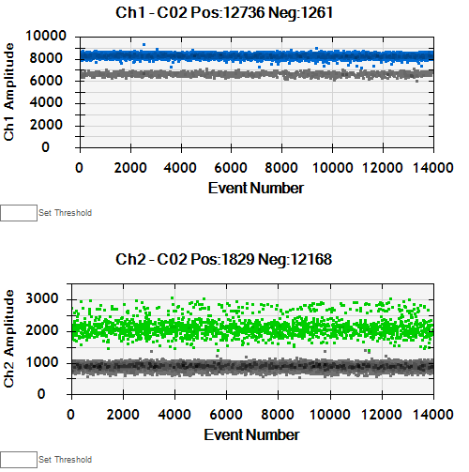
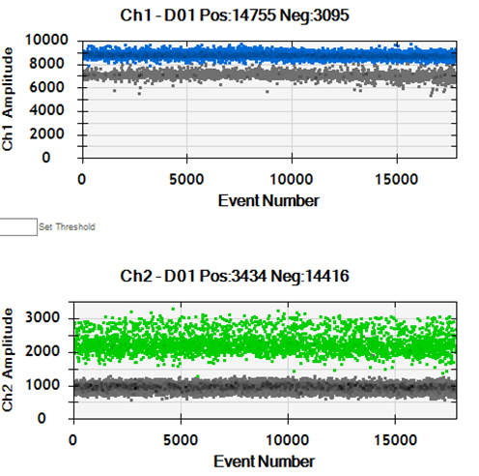
Cut-only initial DNA concentration
250 ng
500 ng
Initial DNA of 250 and 500 ng for Cut-only.
Good separation of FAM (Telomeres) and HEX (646 Single copy gene)
Can be useful for the new SCG to be designed

Slide 5
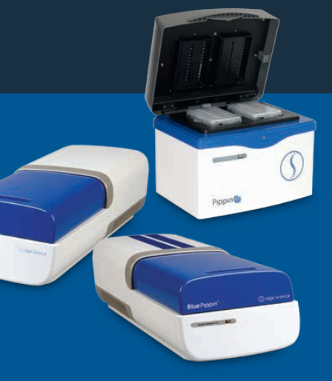
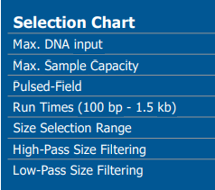
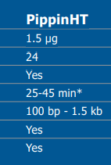
Bluepippin High Throughput
Gel incision by hand is inherently inaccurate and might lead to errors in telomere length measurement. Furthermore, the Bluepippin allows for greater elution yields of DNA from gels, and will allow a smaller initial concentration of DNA to be used for the Cut-only method

